Slide 1
Logical Programming
With Prolog

Slide 2
Logic vs Pure Logic
Our current style of programming seems logical enough, how can we go more logical?
By basing the entire language structure on first order predicate calculus itself.
Logical programming basically consists of stating a problem logically, and asking a question of that problem
The program is basically then a logical deduction to retrieve the answer to that question.

Slide 3
A Crash Course in Logic
Straight from Vulcan to you

Slide 4
Traditional Logic
There are three traditionally held laws of logic:
Identity
A is A, a thing is always equal to itself, a statement always implies itself
Contradiction
A is not not-A, a thing cannot both be and not be something, a statement cannot be both true and false.
Excluded Middle
A is not both A and not-A, a thing either is or is not something, every statement is either true or false.

Slide 5
Traditional Logic
These laws imply that each statement has a value of either true or false.
Once you figure out which it is, the opposite of what you have concluded cannot be accepted.
If you don’t follow the logical laws, then your answer cannot be considered reliable.

Slide 6
Traditional Logic
There are four basic statement forms:
All B is A
No B is A
Some B is A
Some B is not A
The set of rules that govern what you can conclude from a series of statements following the above laws is called syllogism.
Reaching a conclusion from those premises is called inference.

Slide 7
Traditional Logic
All syllogistic rules are based on transitivity:
If A = B, and B = C, then A = C
All Australians like warm weather + all west Australians are Australians => All west Australians like warm weather.
A statement that can be assigned a truth value is called a proposition

Slide 8
Propositions
Propositions are more general than statements in syllogism
There are four rules of inference:
Modus Ponendo Ponens – If P implies Q, and P is true, then Q is true
Modus Tollendo Tollens – If P implies Q, and Q is false, then P is false
Modus Ponendo Tollens – If P and Q is false, and P is true, then Q is false
Modus Tollendo Ponens – If P or Q is true, and P is false, then Q is true.

Slide 9
Traditional Logic
All traditional logic is based on the fact that once something is or is not true, then that value cannot be changed.
This mode of thinking was criticised in the 17th (!) century.
This was because:
No complement definition (everything is positive)
It can’t deduce things dealing with the existence of a member of a class, because that would not use one of the four statements.

Slide 10
Propositional Logic
Level up!
Everything is a Proposition now, starting with atomic propositions (A, B…)
Only concerns itself with the truth values of symbols (not statements) and formulas built from those symbols.
Allows complex formulas to be built by combining symbols with logical connectives
Not, and, or, implies, if and only if
This is what Boolean expressions are based on.

Slide 11
Propositional Logic
The truth value of a well formed formula is the meaning of that formula.
Some formulas have a truth value that never changes:
A or ~A
A and ~A
This is probably the logic you are most familiar with.

Slide 12
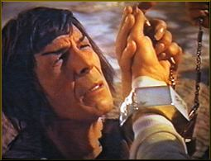
What’s next? Spock Logic?

Slide 13
Predicate Logic
In propositional logic, the basic object is the atomic proposition
In predicate logic, the basic object is the atomic formula
Atomic formula: A predicate symbol and terms that act as arguments to that predicate symbol
The predicate symbol is usually named after the relation between the arguments.
Friends(steve, bob) is true when steve and bob are friends
This is more powerful, because you can make it from other objects.

Slide 14
Predicate Logic
P(a1,a2,a3,…,an) – Every argument is a term
Each term can be a constant, variable, or function!
In propositional logic the truth value of a well formed formula depends on the interpretation.
Atomic formulas have terms, but are atomic… so their interpretation is more complex.

Slide 15
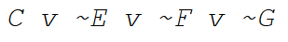
Predicate Logic: Clausal Form
Clausal form is a way of writing formulas in predicate logic using only ∧, ∨, and ¬
A “literal” is a positive or negative atomic formula
A “clause” is a set of literals connected by ∨
Positive literals are at the front of a clause, negative at the back.
Eg:
Horn clauses are a special case with only one positive literal:

Slide 16
Resolution!
Two clauses can be “resolved” if:
One contains a positive literal
The other contains a corresponding negative literal
The two literals share the same symbol
The two literals share the same number of arguments
The arguments of both same literals are the same (or can be otherwise unified)
What this means is that you can use the fact that things can’t be both true and false to find new facts about the world quickly.

Slide 17
Resolution Example
P(a) v ~Q(b,c)
Q(b,c) v ~R(b,c)
Q(b,c) can be both true and false for these statements, so it can be ignored to create a third resolved statement that you can then use in addition to the other two:
P(a) v ~R(b,c)

Slide 18
The Magic Of Logic Programs
Logic languages are written as what to do instead of how to do it.
The higher the level of a programming language, the less detail you have to write.
Highest level languages would just be you asking the computer to do things in natural languages.
“Print sorted array A” – and the computer figures it out.
Logic programming is close but not quite.

Slide 19
Logic Programming
Logical programming is based on automated theorem proving systems.
These were programs that can construct formal proofs of propositions stated in a symbolic language.
Logic programming basically “proves” the solution, and in doing so builds the code to solve it.
Given array A, to sort it, one proves the sorted array exists, and then builds it.
Programs are expressed as propositions that assert the existence of your solution, what to achieve, not how to get there.

Slide 20
Prolog
Computer says no (or false)

Slide 21
What is Prolog?
In the 1970s, a French group called Groupe D’Intelligence Artificielle at Marseille university developed a language to assist in AI development using symbolic logic.
This was Prolog (PROgramming in LOGic)
The first interpreter was available by 1972.
In 1981, Japan built a special research lab for 5th gen computing.
Logic programming (and by extention Prolog) were core to that project.

Slide 22
What is Prolog
Prolog is the logical programming language.
There are other logical programming languages… however they are all dialects of Prolog.
Prolog is an interesting case where there is no reason to reinvent the language.
Due to the logical nature of Prolog, it is very nearly complete for all concepts within it.
It’s also really simple, and surprisingly easy to understand.
However, you may disagree.

Slide 23
Prolog Contributions
Three Major Contributions Prolog brings to programming languages:
Unification
List = [1,2,3].
[1,2,3] = List.
Backtracking
Multiple solutions are sought after
Inferences
Able to create implicit inferences from multiple rules

Slide 24
Unification : Prolog’s Power
Unification in Prolog is the usage of logical resolution to match (some parts of) a query against the heads of clauses in a logical database of functions.
Finding an assignment of values to variables makes the goal identical to the head of one of the clauses, which results in a step by step deduction process that takes the goal and links it up to the logical answer.
Prolog handles variables by either matching the ones in the new head to the old query and assuring all others are set uniformly, or:
Handling any variable clashes by such methods as renaming uniformly.

Slide 25
Prolog Structure
Extremely simple, there are three main parts:
Rules
Facts
Query
Each of these are really simple to write.

Slide 26
Rules
Basically a database of relationships that can be used by the query to unify with the facts.
This is a list of known relationships Prolog can use to find the answer, basically.
Eg: grandparent(X,Z) :- parent (X,Y), parent (Y,Z).
For all X and Z, Grandparent(X,Z) or ~parent(X,Y) or ~parent(Y,Z)
Why this way? Horn clause. Good for resolution.
May or may not be the best way to think about it.

Slide 27
Facts
Are a database of things that are known to be always true.
Eg: father(john,mary)
John is the father of Mary
This is super easy to understand.

Slide 28
Queries
Things you want solved.
These are the goals you set Prolog, and then Prolog tries to use the relationships in your rules segment to prove that what you asked exists from what the facts state.
Eg: :- ancestor(X, cindy), sibling(X,jeffrey)
Is there an ancestor of Cindy who is also a sibling of Jeffrey?
This is always preceded by a “:-”

Slide 29
Other elements of Prolog
Variables
These aren’t your average variables, these are logical variables. They all must start with a capital letter.
Ie: X, Y, Animal, Vegetable, Mineral
Literals
These are actual values things can have. They always start with lower case letters
Ie: x, y, cat, lettuce, granite
Can also be numbers!

Slide 30
General Clausal Form
Prolog has a general format to it’s strucuture:
HEAD :- BODY
Heads can consist of at most 1 relation (function) with any number of variables.
Bodies can be any number of relations which may also contain any number of variables.

Slide 31
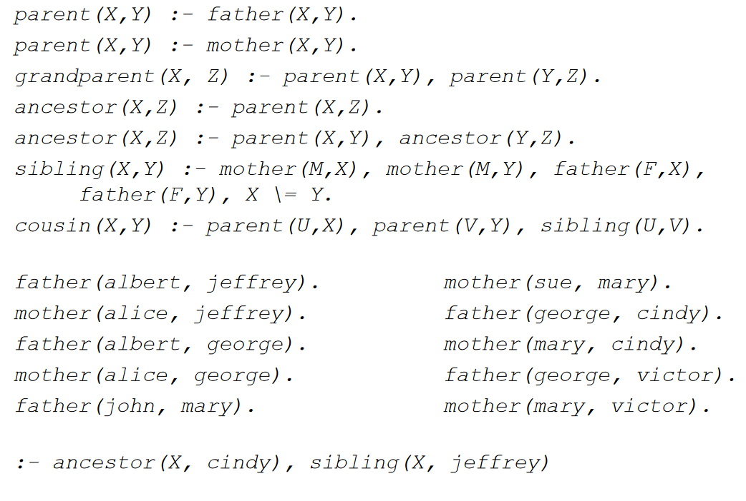
An example program

Slide 32
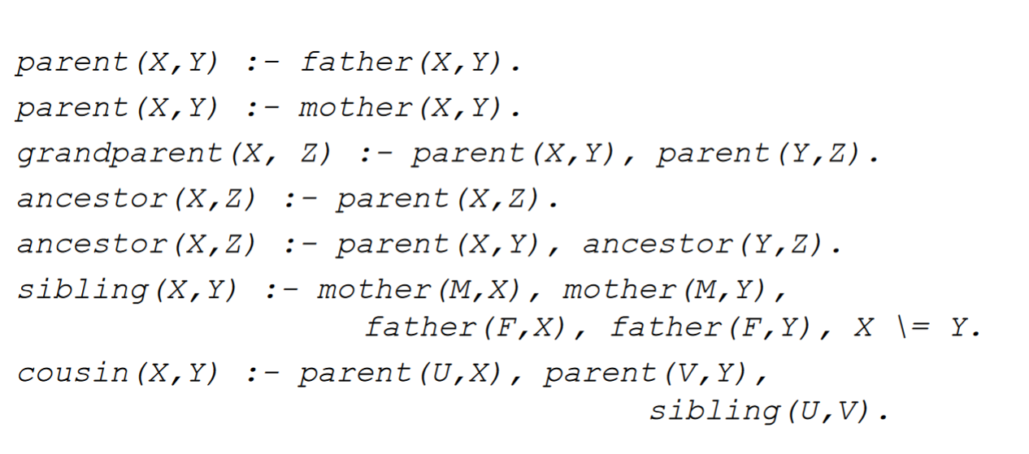
Example rules

Slide 33
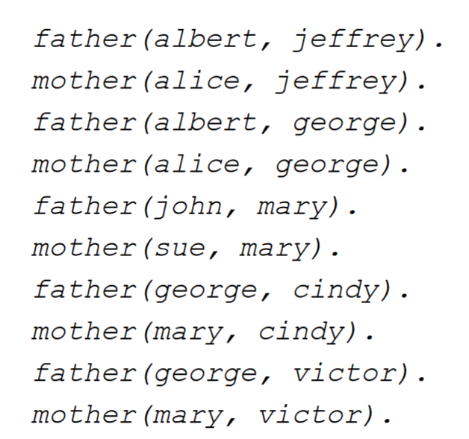
Example Facts

Slide 34
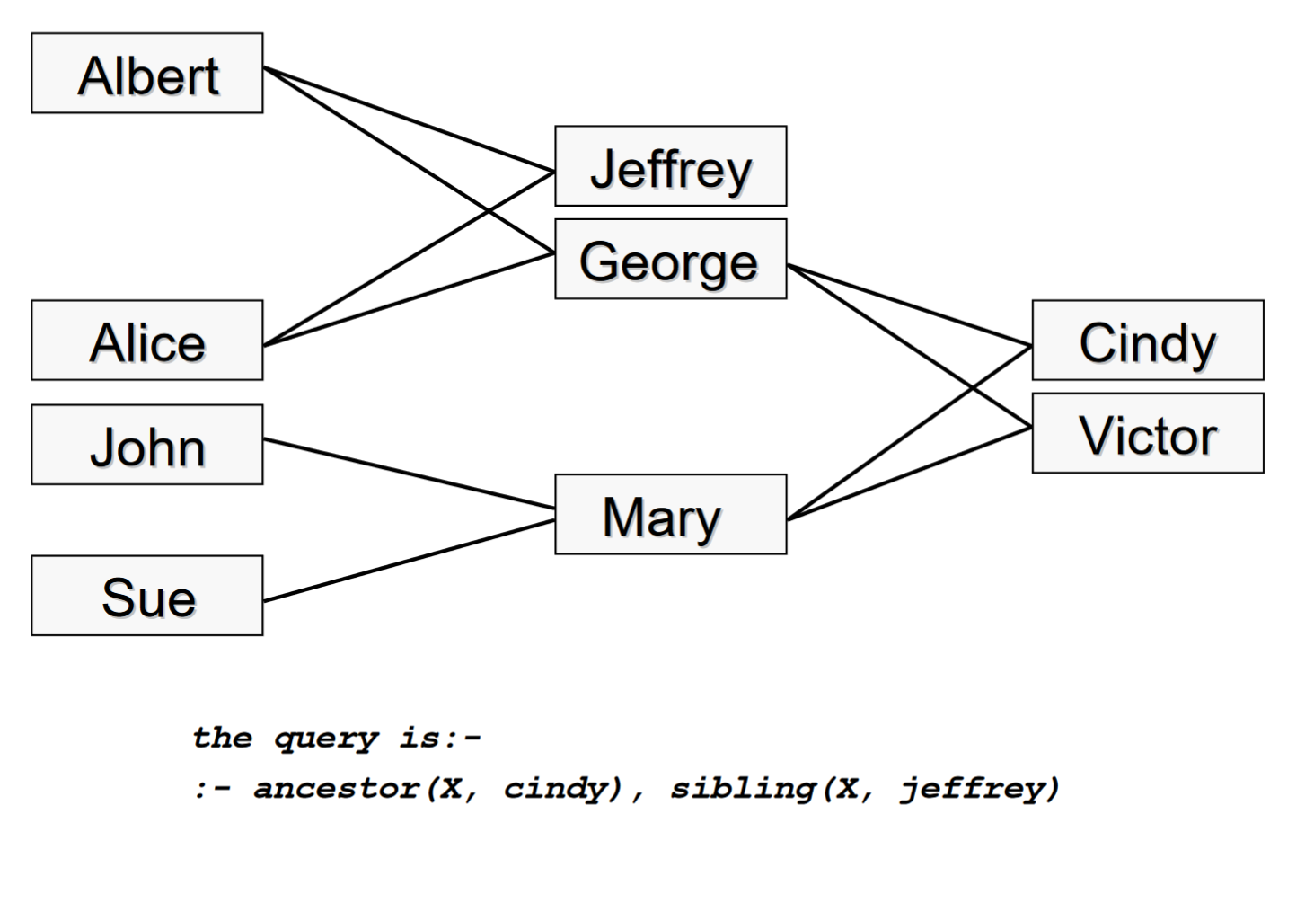
But how does it work?

Slide 35
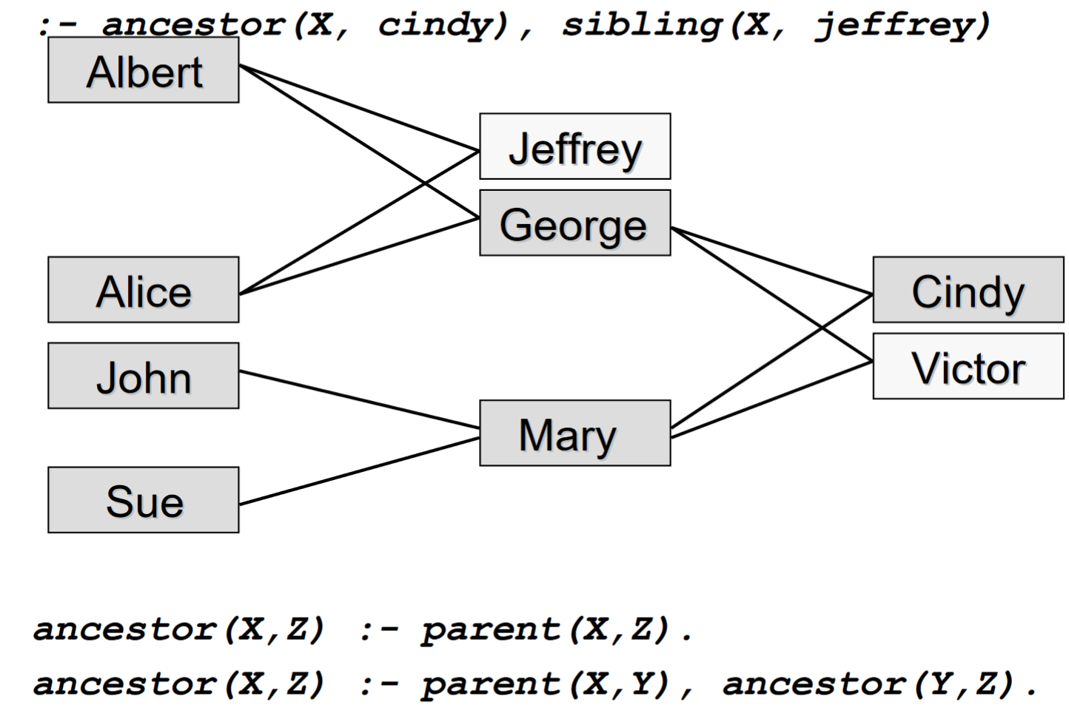

Slide 36
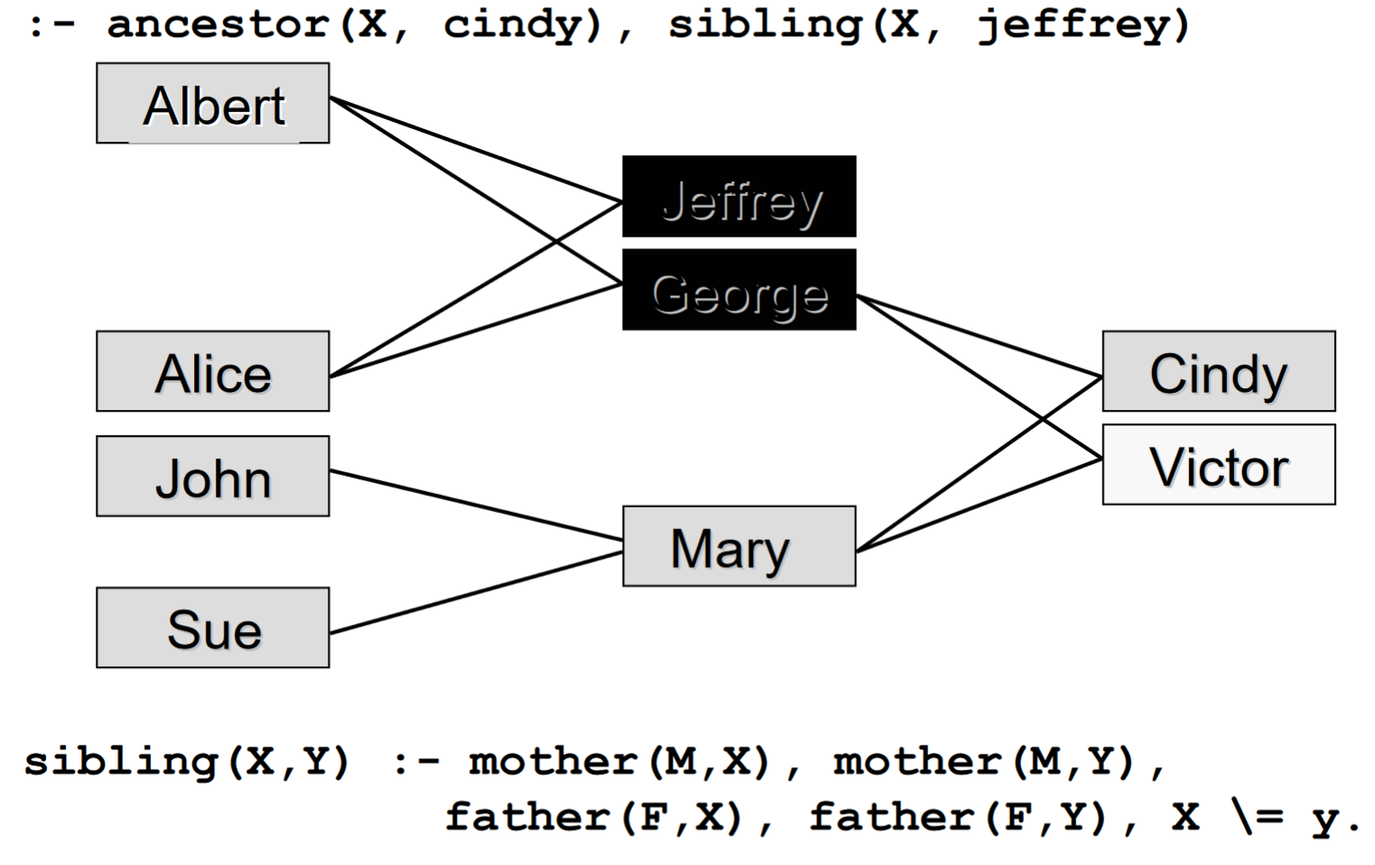

Slide 37
Goals
Queries specify goals for the Prolog interpreter.
They ask “is this true?” with respect to the current database of rules and facts.
Queries can be very complex.
Eg:
Is albert the father of Jeffrey? :- father(albert,jeffrey). yes
Is alice a cousin of john? :- cousin(alice,john). no

Slide 38
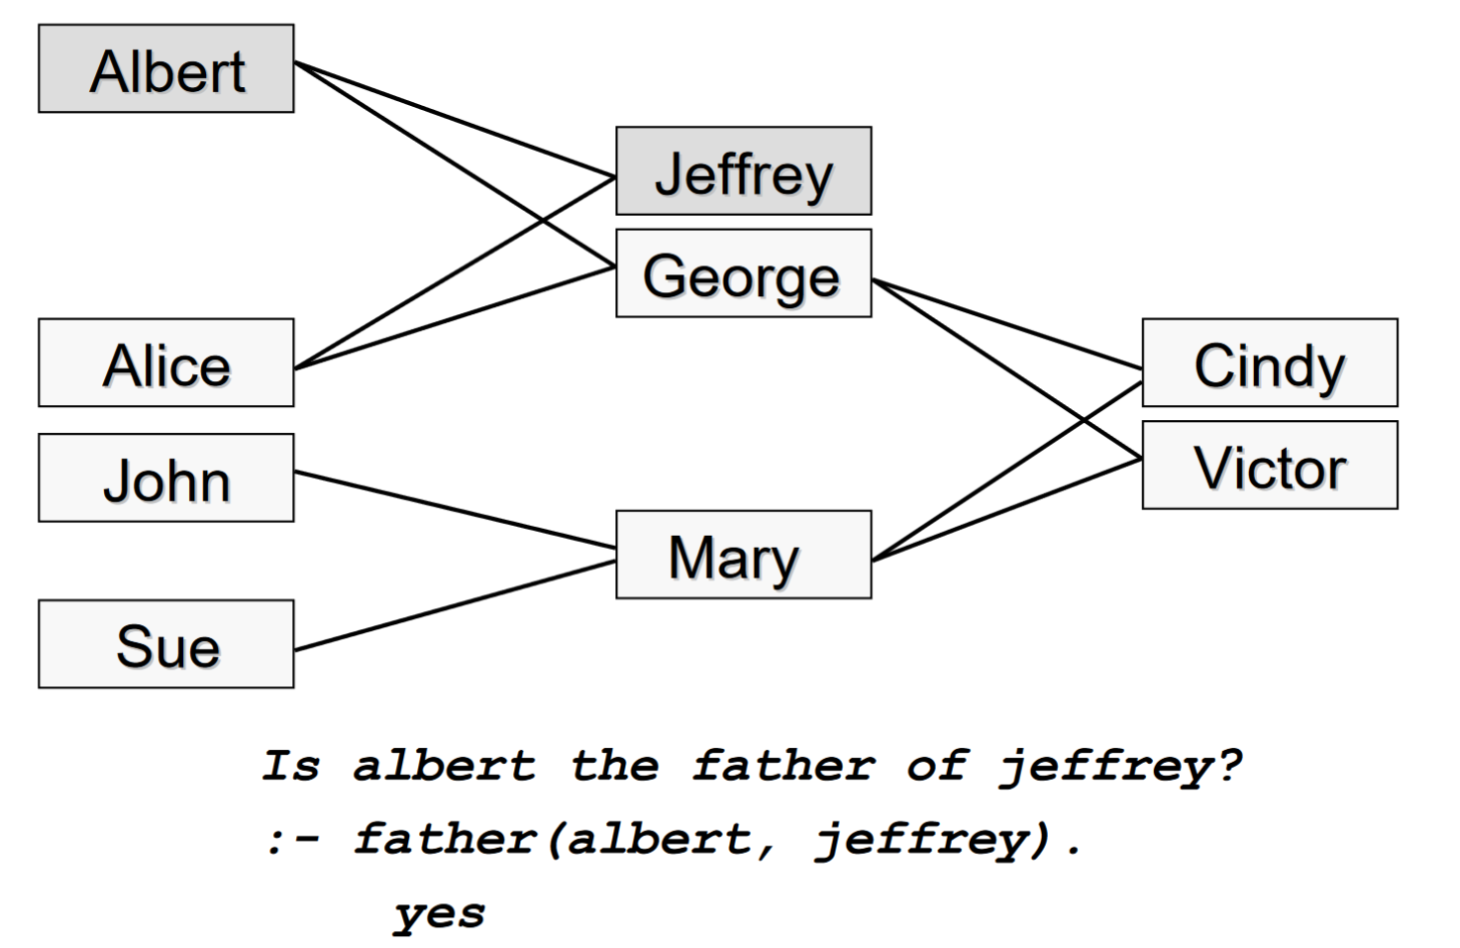
Simple Queries

Slide 39
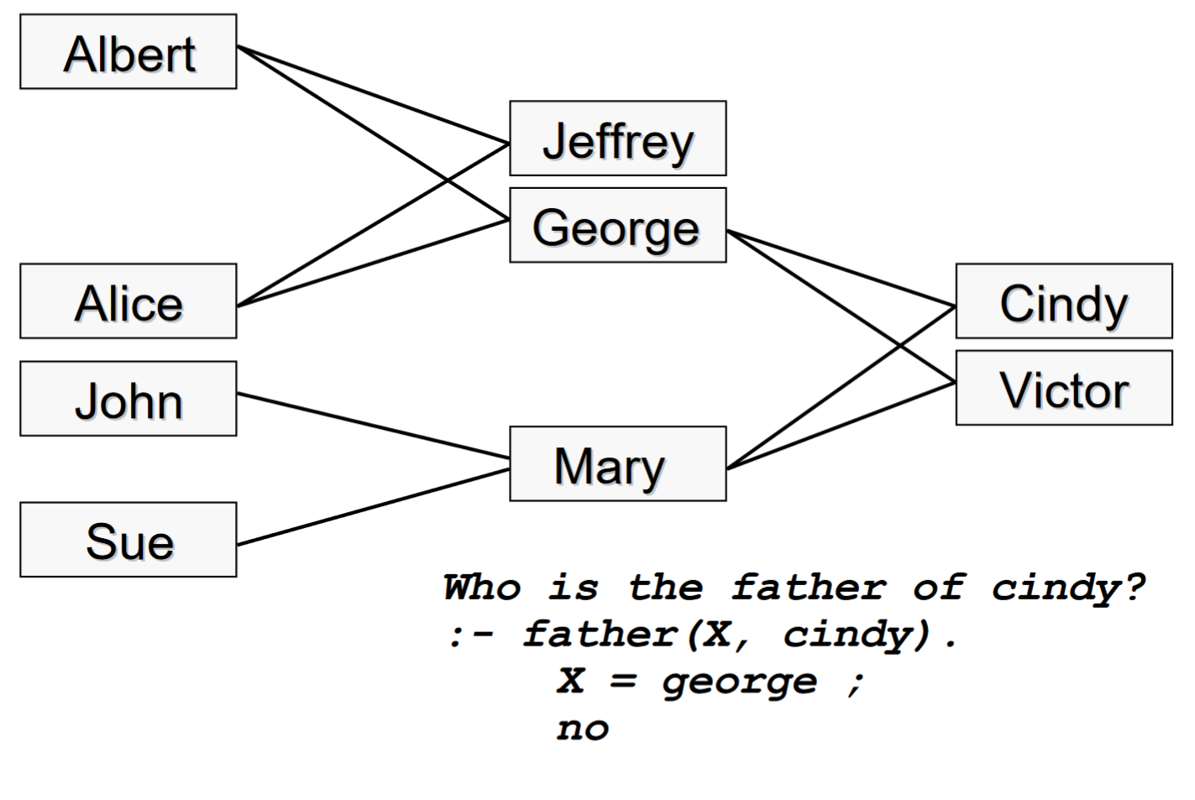
Queries, now with Variables

Slide 40
Multiple Solutions
Prolog’s “;” means that it has unbound variables used in the last goal proof, and prove it again ignoring previous solutions.
Can be done automatically, or manually when requested.
Eg:
Who is George the father of? :- father(george,X). X = cindy ; X = victor ; no

Slide 41
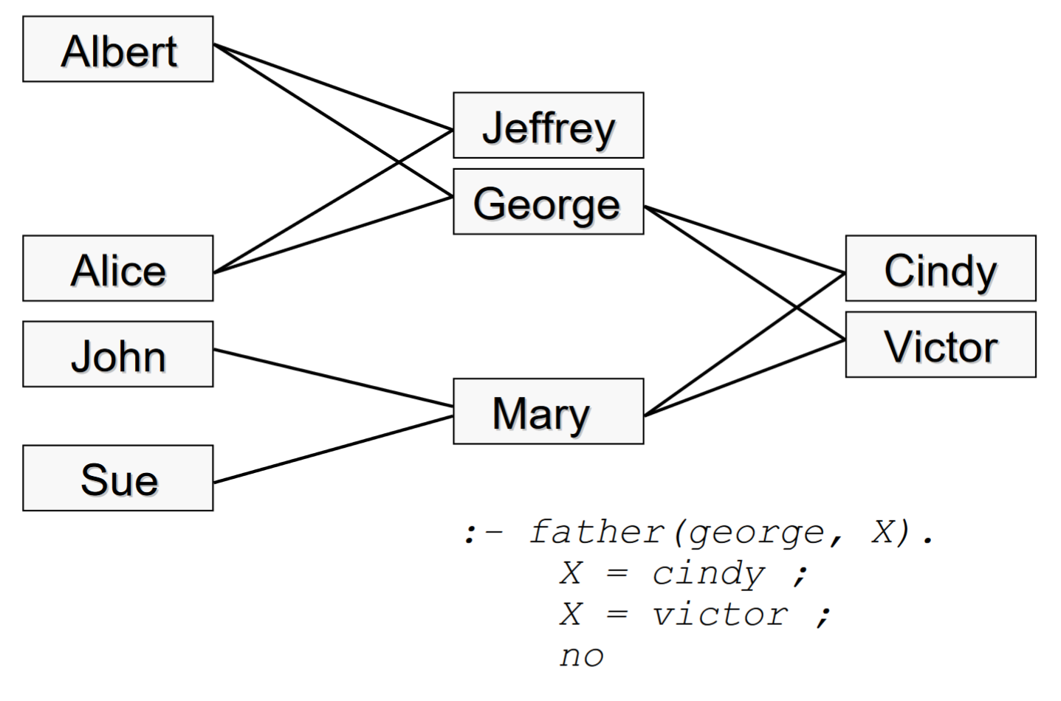

Slide 42
Complex Queries
Commas can allow you to add more clauses to your goal.
Eg:
Is there a person (X) who is an ancestor of cindy and a sibling of Jeffrey? :- ancestor(X, cindy), sibling(X, jeffrey) X = george ; no

Slide 43
To Prove a Goal
There are two methods of goal proving available to the Prolog interpreter.
Unification, or matching with clause heads
Resolution, or proving the corresponding clause bodies.

Slide 44
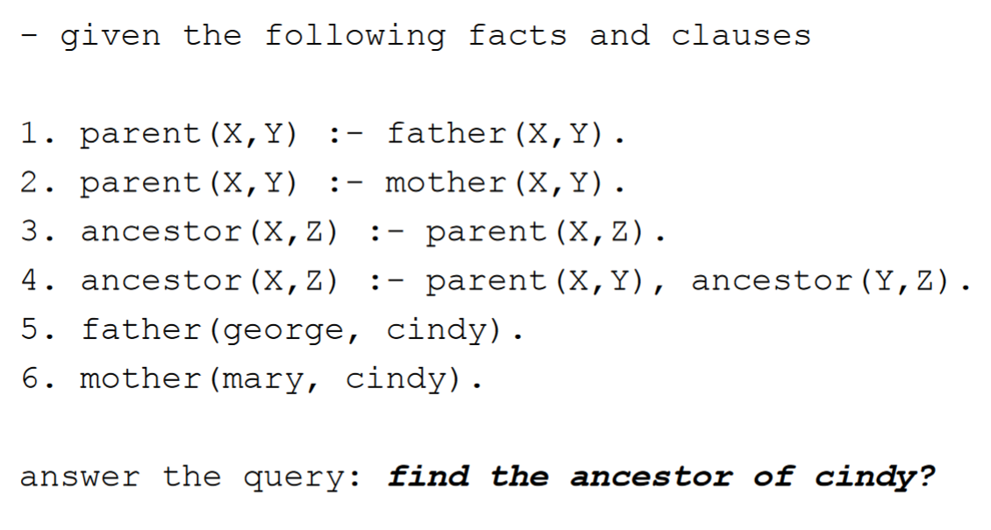
Proving a Goal

Slide 45
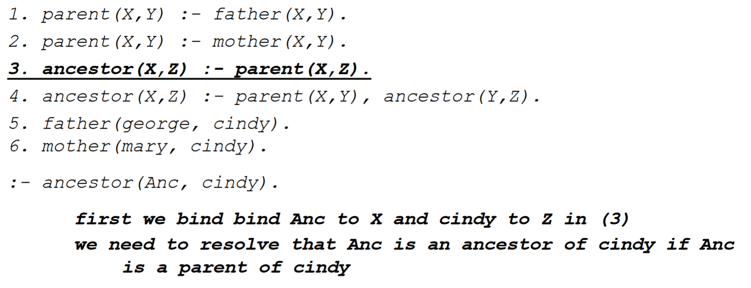
Proving a Goal

Slide 46
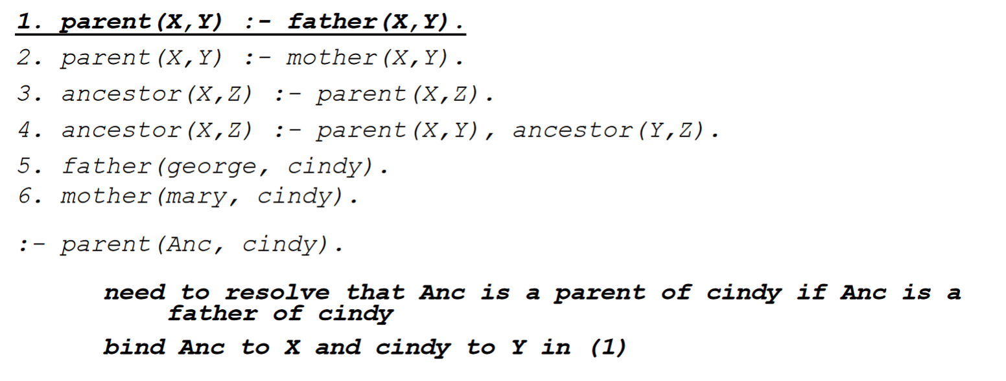
Proving a Goal

Slide 47
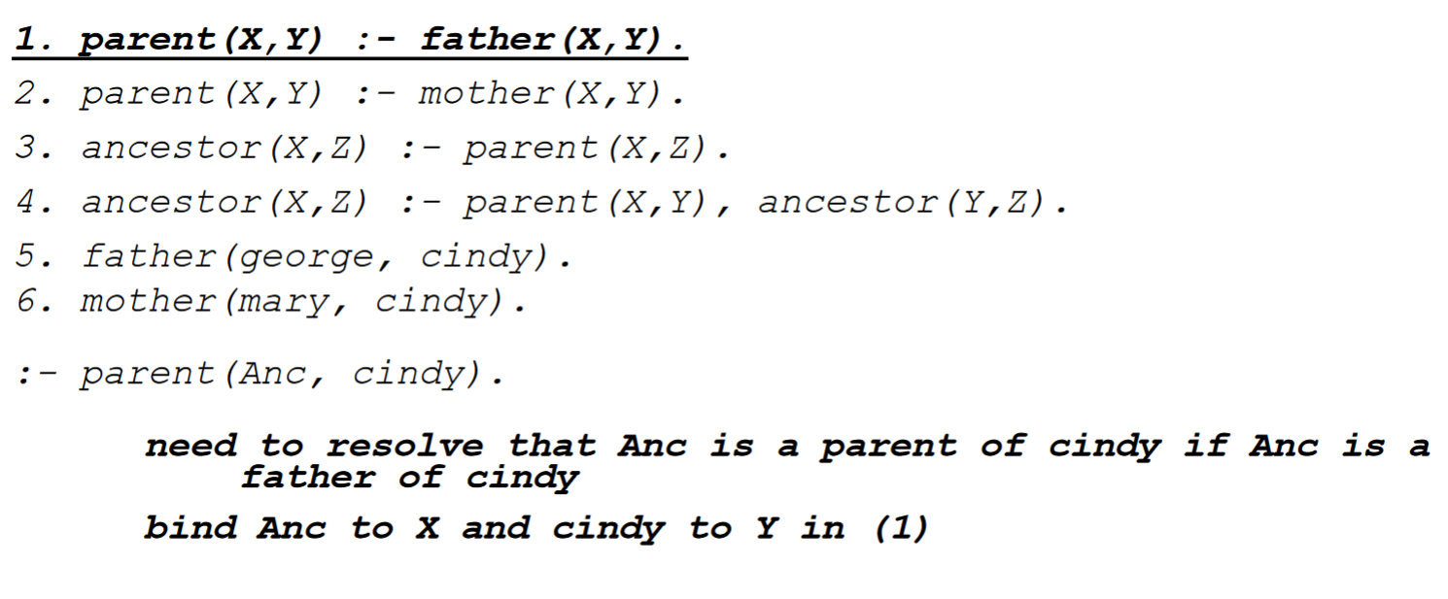
Proving a Goal

Slide 48
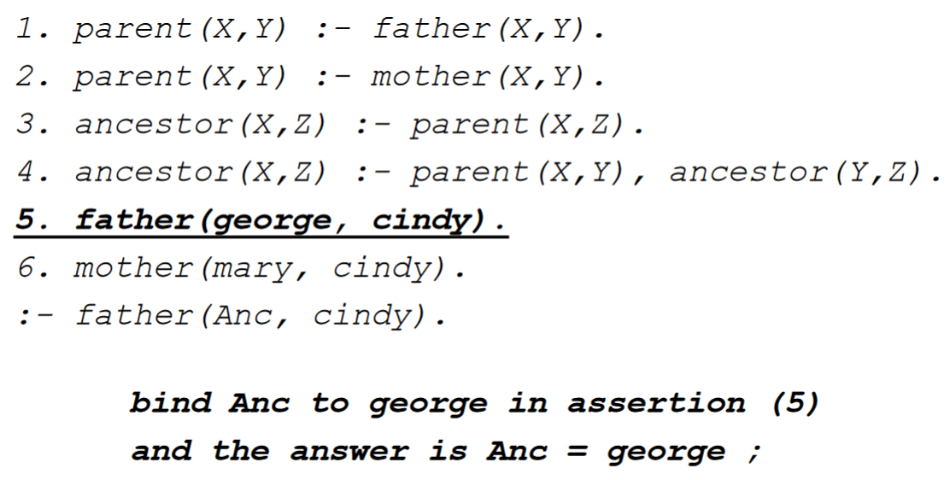
Proving a Goal

Slide 49
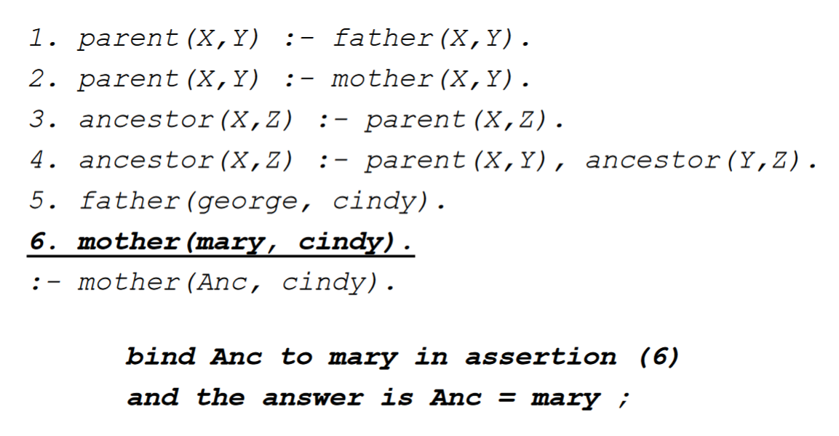
Proving a Goal

Slide 50
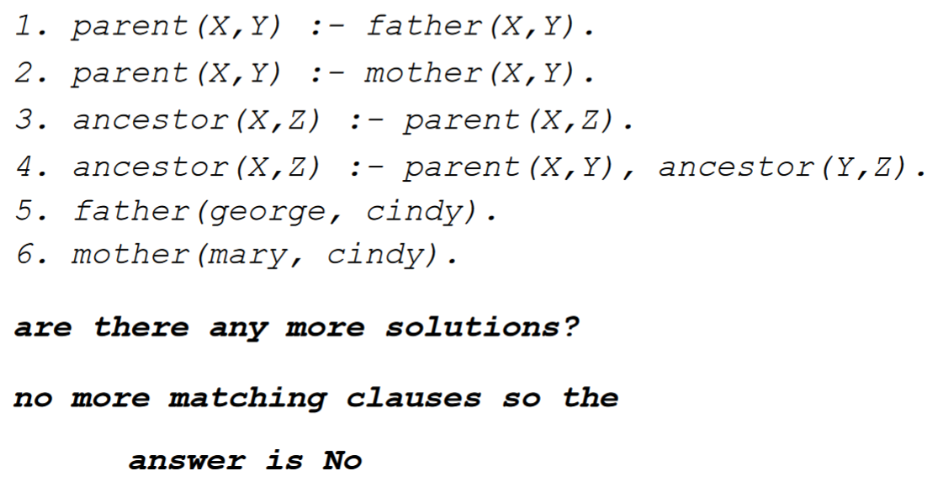
Proving a Goal

Slide 51
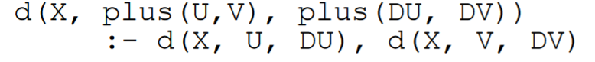
Compound Terms
This is Predicate logic
Each parameter to a relation is a term
But of course, each term can be a relation!
This can make writing complex relations easier
You can write a derivative as:
Or as:

Slide 52
Data Structures
Prolog does not need data structures per se, as the data structures are defined purely by their properties.
The same approach can be used to define primitives!
Defining the properties of say, an integer, can be used to define an integer implicitly

Slide 53
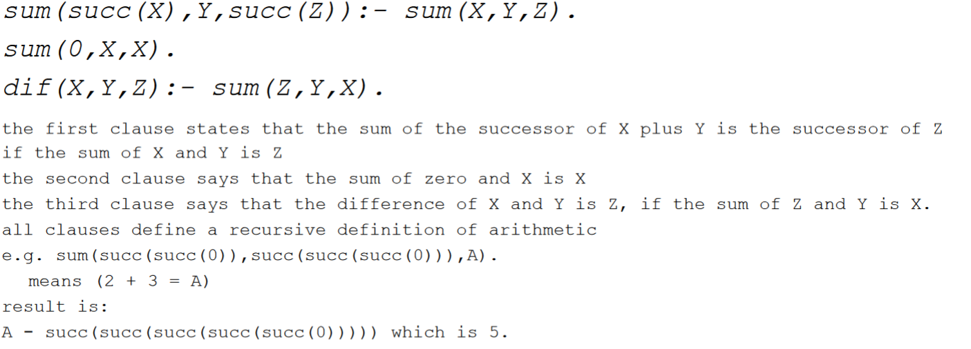
Defining an Integer

Slide 54
Lists!
Prolog also has lists.
These allow for grouping of variables or literals.
You’re probably familiar with this by now!
[] – Empty List
[ H | T ] – cons(H, T)
[ a, b, c, … ] – cons(a,cons(b,cons(c,…(nil)…)))

Slide 55
Append to lists!
Components of lists are accessed implicitly.
append(X, Y, Z) means “unify X, Y, and Z such that Z is the result of appending X and Y together”
Prolog clauses for this are:
append([], L, L).
append(X.L, M, X.N) :- append(L, M, N)
If X is [], return L
Else, Z is the first part of X append N where N is Y appended to the last part of X.

Slide 56
Append
append([a,b],[c,d],Ans) appears as: append(a.b.[],c.d.[],Ans)
Prolog will attempt to match the goal to the clauses in append.
This unification will succeed on the second clause with X=a, L=b.[], M=c.d.[], and Ans= a.N
This leads to the subgoal append(b.[], c.d.[], N)
Eventually, N will bind to b.c.d.[]
This will result in a.N == a.b.c.d.[], or [a,b,c,d]
Tadaaaaa

Slide 57
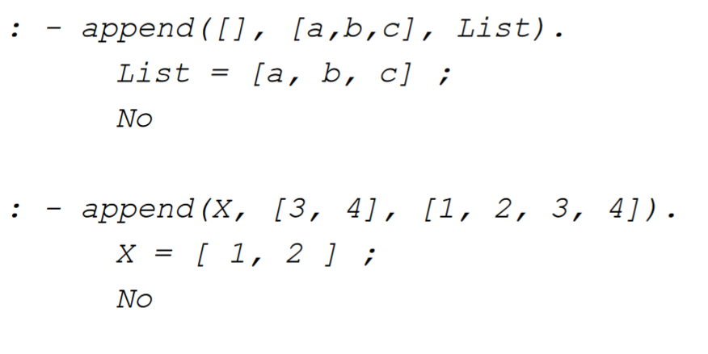
More append examples

Slide 58
Parameters
All parameters in Prolog clauses can be either input or output.
This is determined by what is unifying with it, rather than what it is defined as
This means you can work backwards
Parameters are assigned values during unification
And to make it more confusing, parameters can be partially completed (they may contain relations themselves)
This makes Prolog extraordinarily expressive.

Slide 59
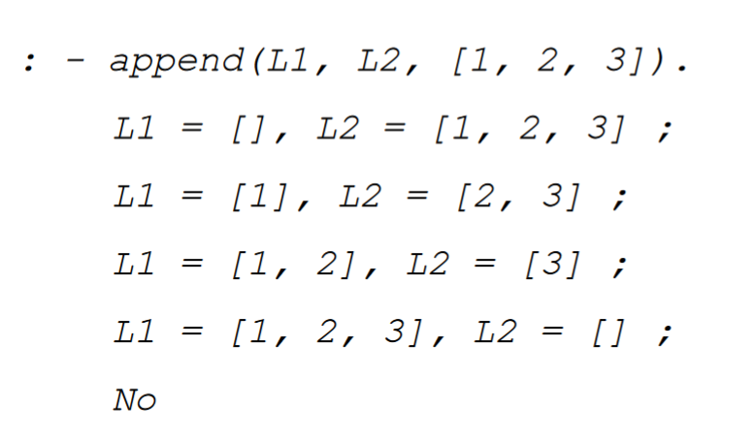
Working Backwards

Slide 60
Closed World Assumption
Prolog always assumes that the rules and facts you define encompass the entire world
If something cannot be proven true, it must be false.
This means that Prolog cannot be complete for real world systems
It also means that only things that can be proved from rules and facts are true, and the only things that are true are things proved by the existant rules and facts.

Slide 61
CWA causes Problems
If I neglected to define Albert’s mother and father (perhaps because I don’t know, or I was lazy and knew I didn’t need it for whatever calculations I was running), as far as Prolog is concerned Albert never had any parents.
So if I ask: :- parent(X,albert).
The answer will be: No

Slide 62
Closed World Assumption?
CWA is reasonable if we can cover all true statements for our problem with rules and assertions.
It becomes unreasonable when you deal with situations that require
Infinite sets of rules
Undefined number of facts
Worlds where rules change unpredictably
This means you can’t make Prolog learn per se.
However, you can make it work if you can predict how the world will change.

Slide 63
Negation in Prolog
How does one prove a negative in logical terms?
Negation by failure!
Not(Pred) – Succeeds if Pred doesn’t, and results in no instantiation of any variables.
Not(Not(Pred)) – Succeeds when Not(Pred) doesn’t, but is not equivalent to Pred!
Wait, why is a double negative not a positive?
This is a function of logic.

Slide 64
Example, Russell’s Teapot
I state that there is a teapot orbiting the sun somewhere between mercury and venus.
Call this “Teapot”
Now obviously I can’t prove “Teapot”
:- Teapot(). No
But you can’t prove there is not a teapot either!
:- Not(Teapot()). No
But that means that Not Not Teapot is true! So there must be a teapot!!

Slide 65
The world is infinitely teapots
This is obviously preposterous, as I could use double negation to prove anything that cannot be disproven.
This is a misunderstanding of logic: Double negation means only that we failed to prove something false, not what it was that made us fail!!!
Be extremely careful when using double negation in logical programming, as it follows this pattern.

Slide 66
Problems with inequality and Prolog
Inequality in Prolog:
Depends on the negation definition
Produces inconsistent and unexpected results
Closed world assumption makes this worse
Be Careful!

Slide 67
Control Structures
Logic programming has no control structures.
All control derived from unification/resolution
Order of statements is irrelevant!
Prolog on the other hand is interpreted in a way that is related to the order of statements
This means the order of matching is the order of statements!
Implicit control exists.

Slide 68
Wait, that’s against Logic!
Logical analysis – generates correct clauses to represent the solution
Control analysis – order your clauses for optimum efficiency!
However
Ideally, you want the programmer to do the logic, and the compiler to do the control
In reality, the programmer has some level of control
Pure logic seperates order and control, but Prolog doesn’t!
Prolog is only logic-oriented! (but that’s as good as it gets)

Slide 69
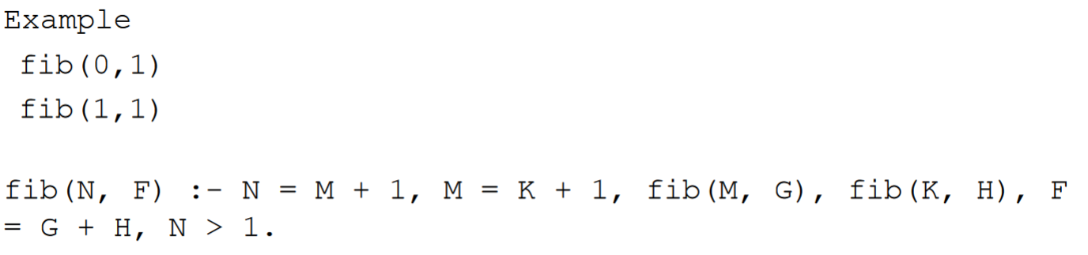
Backward Chaining
Start from the goal, work backwards to achieve the hypothesis
Top down control process
It’s also very similar to recursion

Slide 70
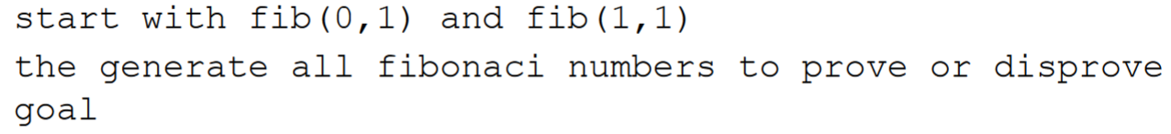
Forward Chaining
Start from hypothesis, attempt to reach goal.
Bottom up control
Similar to iteration

Slide 71
Forward V Backward
Forward chaining
Useful when:
More rules than facts
Justification for result is needed
There are fewer choices
Backward chaining
Useful when:
There are only one or very few choices for clauses to resolve with a goal
There is not much backtracking

Slide 72
Searching
To prove something, you need to search through a list of clauses to find unifiable terms and resolvable clauses
Prolog searches from top to bottom, one at a time
So, you need to organise the clauses in the appropriate order to make Prolog’s life easier.
Prolog uses a depth first search, so try and have the shallower choices first, and the deeper choices after.

Slide 73
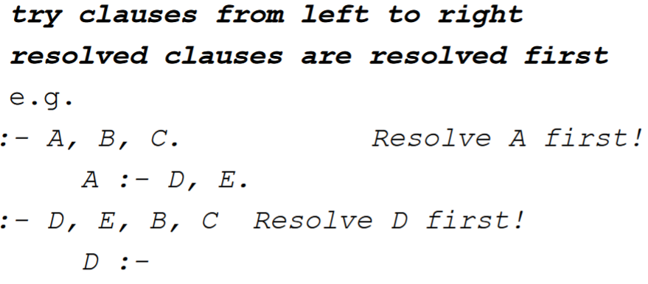
Prolog Resolution Example

Slide 74
Depth First Search
Goals are pushed into a stack
This method is easiest to implement on sequential machines
Always memory efficient and will eventually find a solution.
However that eventually may be when time = infinity.

Slide 75
Breadth first search
Goals are pushed into a queue
Pursues alternative paths in parallel
Great for high parallelism
Guaranteed to find shortest path
Uses exponential amounts of memory

Slide 76
Handling Failure
If Prolog cannot find a clause to resolve properly to, what does it do?
Undo the last resolution completed
Start over trying other clauses
This is called backtracking, and is basically taking one step back up the tree.
This is what makes depth first search complete.

Slide 77
Cut!
The cut “!” command is a way of telling Prolog that the backtracking is not to be done using goals posted before the cut.
Ie, once we have passed the cut, if you have to backtrack past it again, automatically fail.
This prevents re-evaluation of statements that precede it.
This can prune the search tree so you don’t have infinite loops.

Slide 78
Problems with cut
It’s not logical!!
It encourages procedural style programming in logical environments!
Procedural logic programs are hard to understand for the same reason C++ and Perl can be hard to understand.

Slide 79
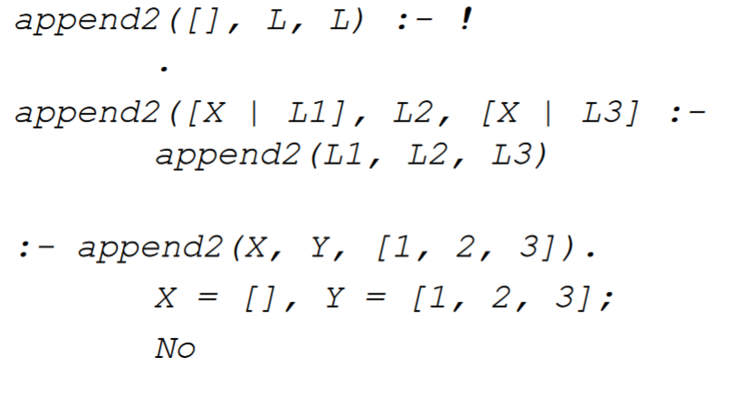
Cut Example

Slide 80
Non Monotonic Reasoning
Monotonic reasoning is what Prolog uses
If something is true it is always true
This is not how the real world works.
Non-Monotonic reasoning lets you update rules and facts to update the real world.
You must have some idea of why these update first though.
Use:
assert – Add or retract rules
retract – remove rules or facts.

Slide 81
Logic Programming
Pure logical programming is characterised by:
Very high level programming
Logic and control are separated from eachother
Easy to prove that a program is correct
Easy to automatically optimise programs
Prolog on the other hand, comes close, but:
Is impure
Cut and co encourage procedural styles
They also make sequential processing more efficient
Is quite inefficient itself (although the Japanese Prolog machines are really fast)

